Slide 1

ENME480 – Dynamics & Inertia
Alex Beyer, Kaustubh Joshi

Slide 2
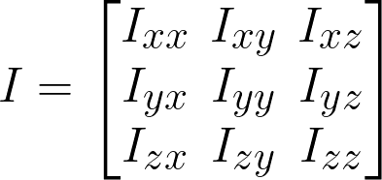
The Inertia Tensor
Bodies have different inertia about every possible axis of rotation
For the sake of simplicity, we divide the terms into two categories (Principal Moments and Cross Products) and collect all of them into a matrix I:
Cross Products
Principal Moments

Slide 3
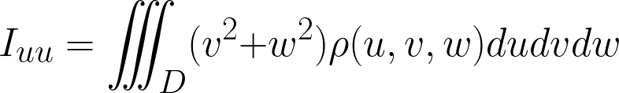
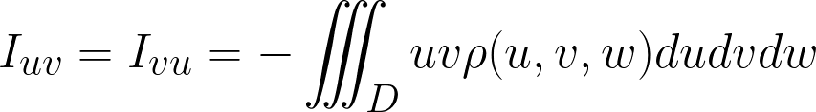
The Inertia Tensor – Finding Elements
The Inertia Tensor is defined by two integrals, one per type of element: (substitute x, y and z in as needed)
Principal Moments
Cross Products
The Inertia Tensor is symmetric!

Slide 4
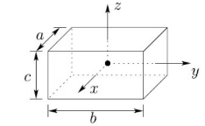
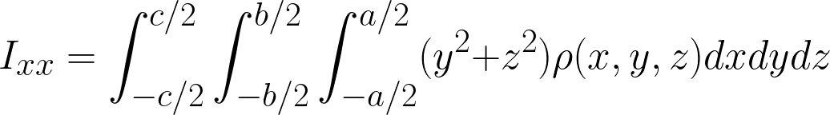
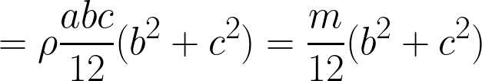
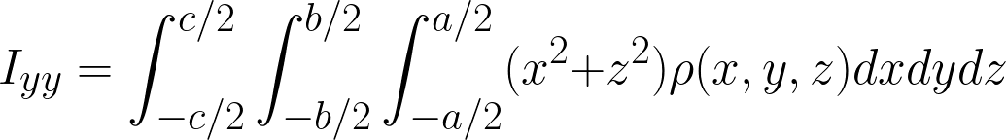
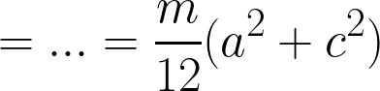
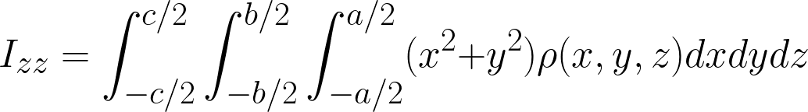
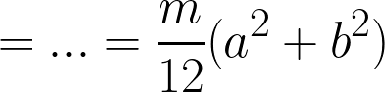
Inertia Tensor Example - Box
Let’s solve for the inertia tensor of a box with side lengths a, b and c and density ρ
First, try finding the Principal Moments…
Are there any patterns we notice?

Slide 5
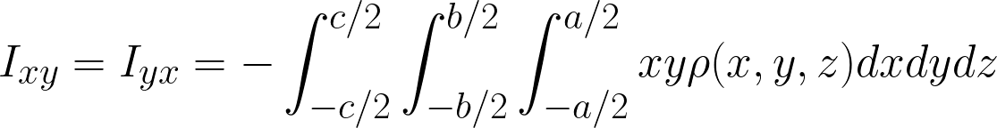
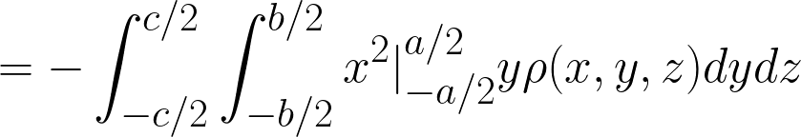
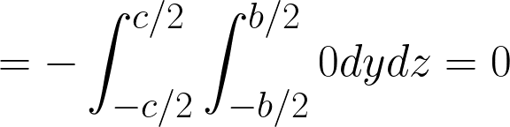
Inertia Tensor Example - Box
Let’s solve for the inertia tensor of a box with side lengths a, b and c and density ρ
Now, let’s find the cross products:
For a MoI about the geometric center of a symmetric object, all cross products are zero, but why?

Slide 6
Understanding The Inertia Tensor
Defn: Inertia
The tendency of an object to resist changes in its state of motion
An object having zero inertia is equivalent to saying the object will not resist a change in its rotation
Why does symmetry lead to zero inertia?
Being at the geometric center of an object means the mass is balanced on either side – a perfectly balanced object provides no resistance to rotation and will spin forever absent friction

Slide 7
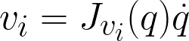
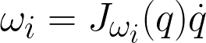
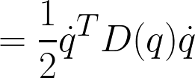
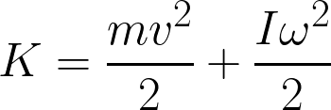
Kinetic Energy
The Jacobian maps joint variable derivatives to linear/angular velocities, letting us say:
Further, if we define R as the transform between world and body frames, we find:
This looks scary, but its just the matrix version of:
We call this component D (or M) – the Inertia Matrix

Slide 8
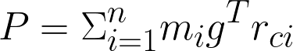
Potential Energy
In the absence of other forms of energy storage, potential energy only depends on gravity:
Where g is the vector defining the force of gravity and r_{ci} is the vector of CoM coordinates for link i
This definition only accounts for gravitational potential, but other potentials are easy to add!

Slide 9
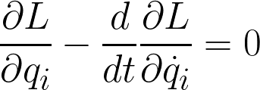
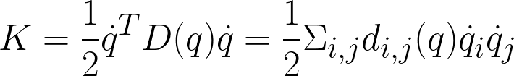
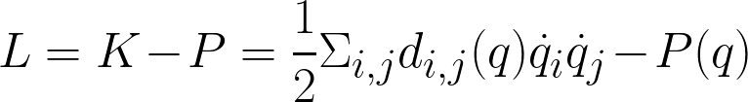
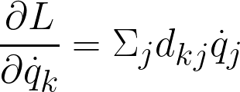
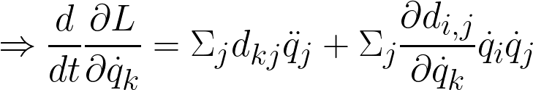
Equations of Motion
Lets solve out the Euler Lagrange equation to find EoM:
We can re-express Kinetic Energy and find:
(i,j)th entry of D

Slide 10
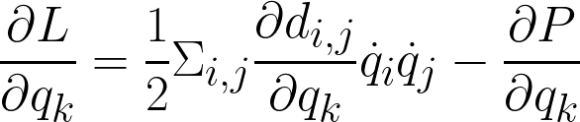
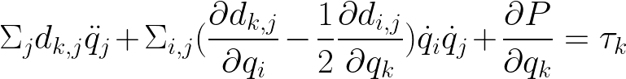
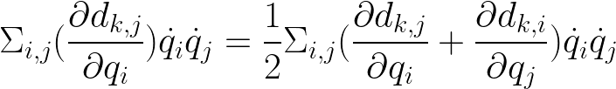
Equations of Motion
We can find the final component of the Euler-Lagrange equation as:
Allowing us to rewrite the full thing as:
Cleaning up sums and using symmetry yields:
Control Input

Slide 11
Equations of Motion
Recognize we have 3 types of terms here:
Terms involving the 2nd derivative of joint quantities
Terms involving products of 1st derivatives of joint states, which come in two flavors
Squares of the same derivative, representing Centrifugal Forces
Products of derivatives with different bases, representing Coriolis Forces
Finally, terms which only involve the joint states, arising from differentiating the potential

Slide 12
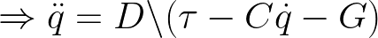
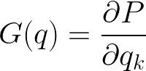
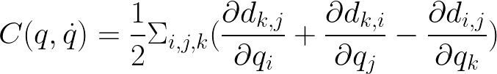
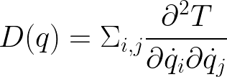
Equations of Motion
Grouping terms gives us a representation of the dynamics:
We can also solve for these terms directly:
Note: These definitions are not necessarily unique!

